Slide 1

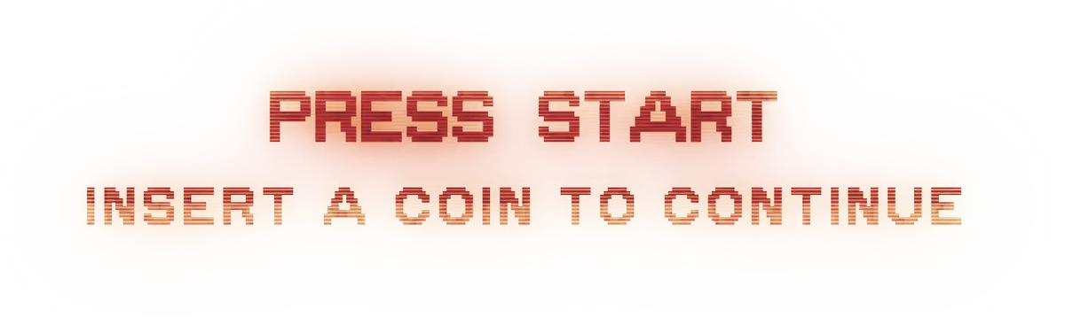

Event Sourcing and CQRS
on Azure serverless functions
Duncan Jones
💬 @Merrion
Notes:
Good afternoon and thank you for lending me your time.

Slide 2
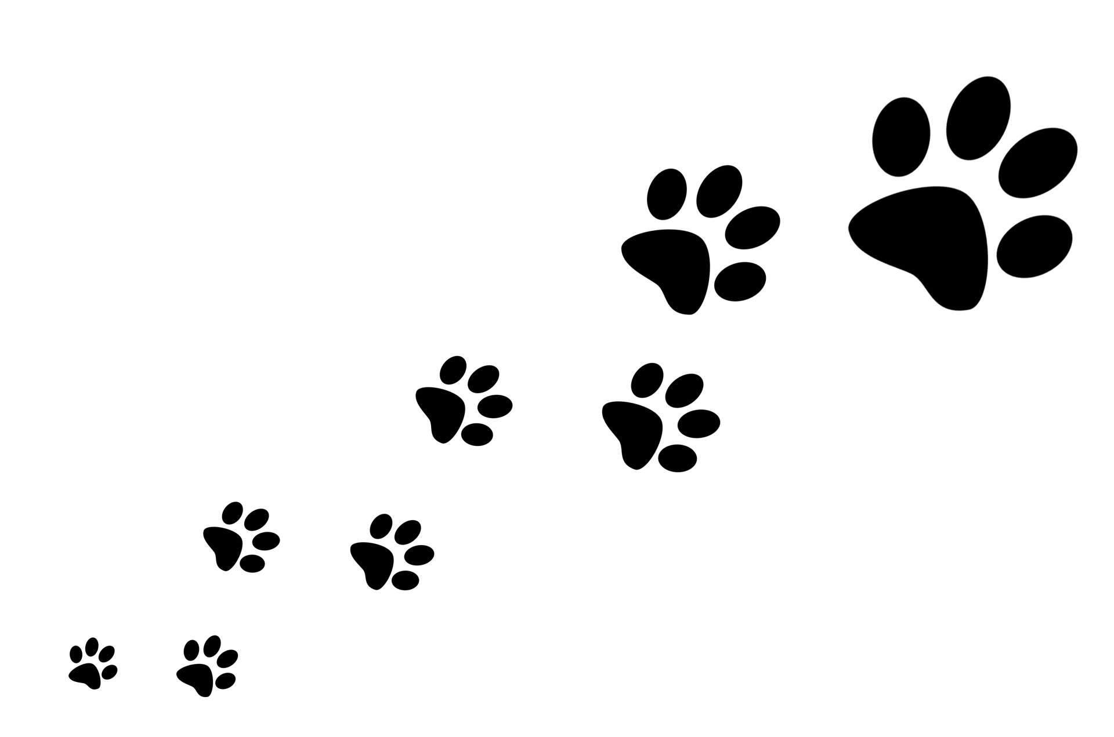
Agenda
Motivation
Introduction to “event sourcing”
Walk-through example
Notifications
Introduction to Azure Event Grid
Notes:
First I need to discuss where cost comes from, in the context of cloud computing.
Then a very high level overview of event sourcing because the solution I have put together makes extensive use of this (and I will explain why at the same time).
I will also show some code to illuminate how I am doing this
Then the environment in which this is to be hosted – using the Azure Event Grid, Durable Serverless functions and Azure storage.
Then I will walk through an example of the way the architecture hangs together
Finally I’ll wrap up with lessons learned and Q&A – hopefully questions form you, probably questions from me and maybe even questions from the crocodile.

Slide 3


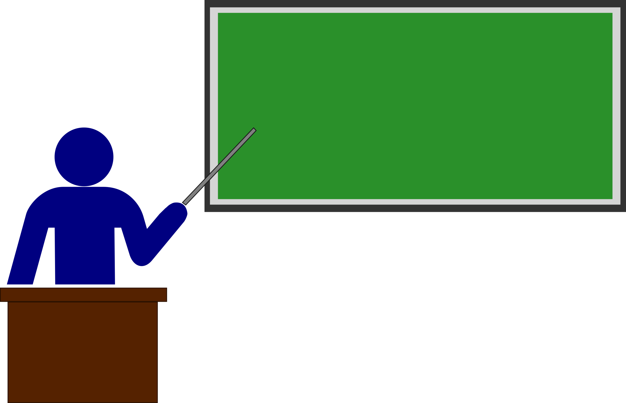
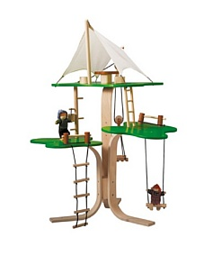
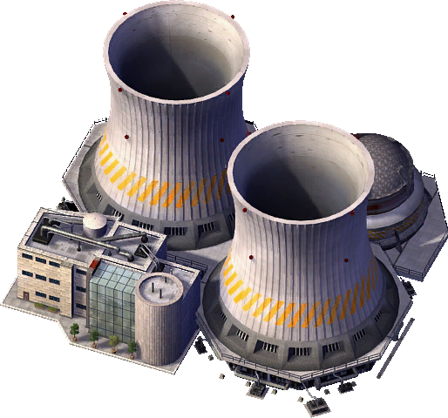

Caveats
Notes:
Some caveats to set expectations:
The system I am describing here is best suited to non critical or occasional/burst use scenarios rather than enterprise critical systems and is tuned toward minimising cost rather than maximised performance. If you are having talks with venture capital firms or describing yourself as “the uber of blah” then this may not be ideally suited for you.
Also, what I am describing is more of an experiment rather than a definitive textbook example.
To manage expectations, what I am looking for is an equivalent to what Blogs did for micropublishing in applications.

Slide 4
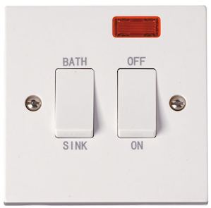
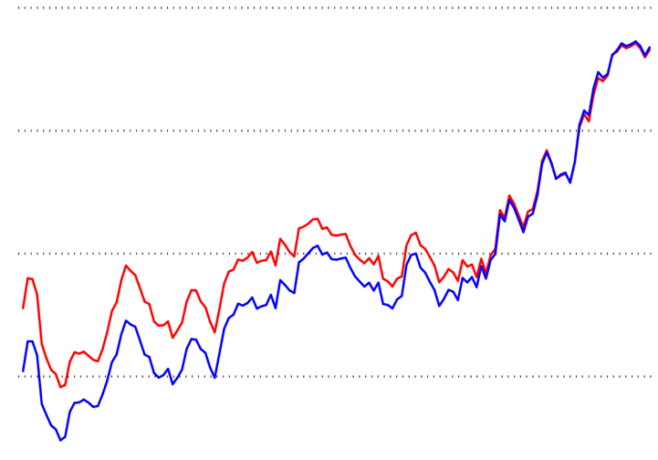
Motivation: Addressing sources of cost
Fixed costs
Overprovisioning
Notes:
There are two main sources of cost that we need to address with regard to cloud hosted systems:
The first is always-on systems, for example virtual machines, for which a cost arises regardless of use.
The second is overprovisioning, where we have to reserve more processing power than we are using so that we are able to ramp-up to match rapidly increasing demand.
Azure serverless functions address these two sources of cost “out of the box”

Slide 5
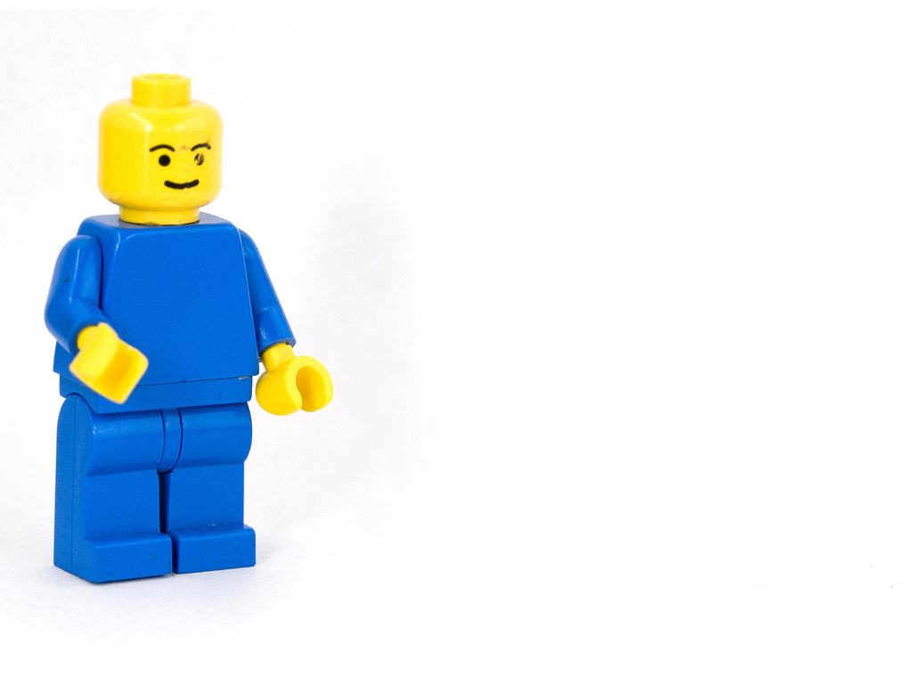
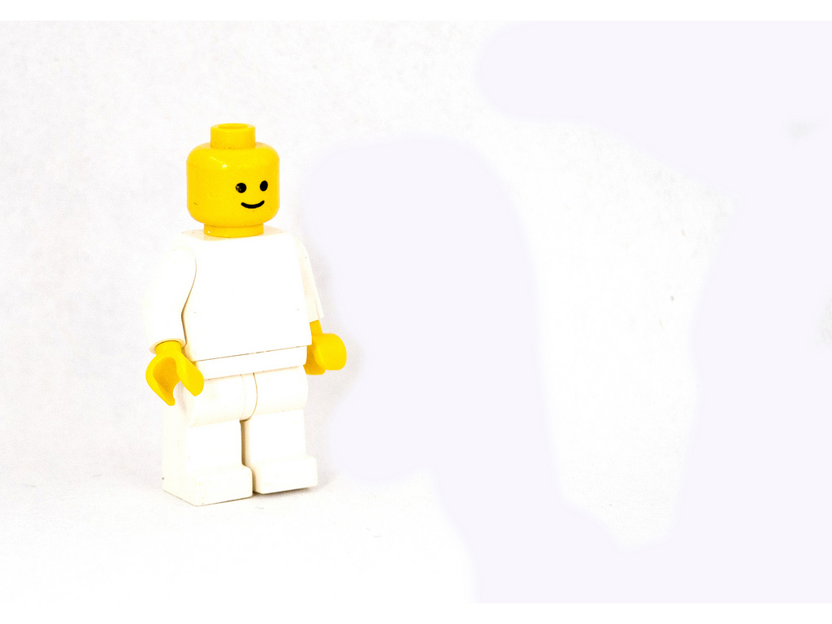
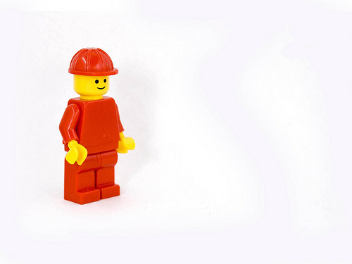
Event stream based example
Open
Account
Deposit Money
Withdraw Money
Aidan
00001
$10.00
$5.00
Open
Account
Deposit Money
Withdraw Money
Close Account
Margaret
00002
$10.00
$10.00
Open
Account
Deposit Money
Fearghal
00003
$5.00
Notes:
In an event sourcing system we don’t store the state of any entity but rather store a history of all the events that have occurred to that entity and then derive the state by reading that history.
The best way I can explain this is with an example, and the usual example for event sourcing is the bank account example.
This is how data gets stored in an event sourced system.

Slide 6
Projection
Open
Account
Deposit Money
Withdraw Money
$10.00
$ 3.00
$10.00
$ 7.00
As at event number 2
Balance
Event Type | Action
Open Account | Skip
Deposit Money | Increase balance by $
Withdraw Money | Decrease balance by $
Notes:
Since running a projection incurs a cost, my preference is to run it on demand – meaning that you only incur the cost if you need to get the state of an event stream backed entity
In addition to the state, a projection should also return the event sequence number of the last event it read in deriving the state – why this is needed will become obvious later on

Slide 7
Event sourcing “rules”
Event streams are Append Only
Events are Immutable
Event names are past tense
Events are for one entity

Slide 8
Q & A
Notes:
Because everything else builds on this I will just pause to see if there are any questions about event sourcing as an idea?

Slide 9
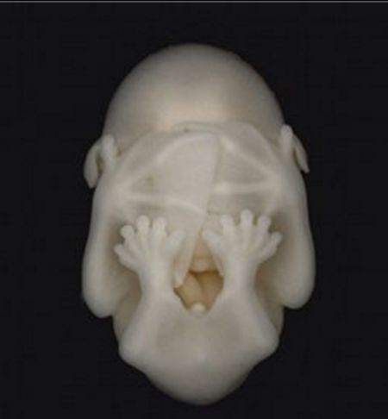
Event sourcing on Azure functions walk-though example
https://tinyurl.com/es-bank
Notes:
So let me show you what the code looks like in practice
(If you would like to have a play along there is a Blazor front end at the above URL)

Slide 10




Open a new account
Each account number must be unique
Concurrency crocodile!
Initial deposit amount (optional)
Beneficiary name (optional)
Notes:
We will start with opening a new account.
The rules are :-
An account can only be created once - therefore if an event stream already exists for the account, do not create a new one or append an account opened event.
This means we need to look out for a concurrency crocodile – what happens if two functions try to open an account with the same number at the same time.

Slide 11

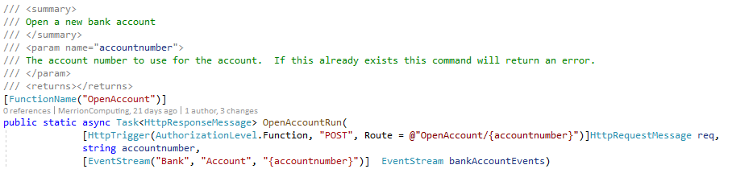
Open a new account
https://retailbankazurefunctionapp.azurewebsites.net/api/OpenAccount/A001B123456C
DOMAIN
ENTITY TYPE
INSTANCE
Notes:
When the serverless function is triggered the account number is taken from the URL and is used to instantiate a new eventstream variable for that bank account.
Each event stream is uniquely identified by a combination of the domain, entity type and unique identifier of that entity. This is basically a primary key for the entity.

Slide 12
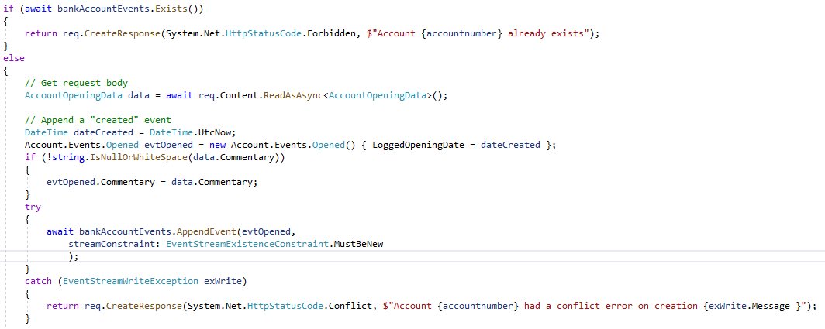
Open a new account
Notes:
1) To enforce the constraint that an account must be new we can first check the event stream does not exist, but also we can pass in a constraint that when writing the first event the event stream must be new.

Slide 13
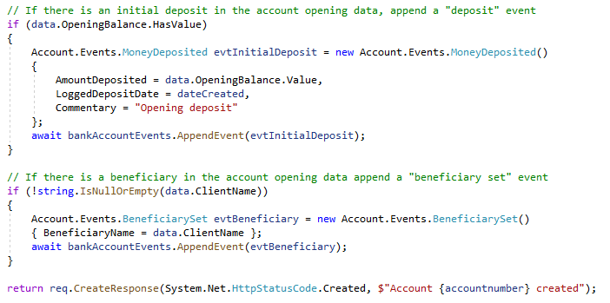
Open a new account
Notes:
In addition, the same function is able to append more than one event onto the event stream if that makes business sense
Here I am adding a deposit event if the account is opened with an initial deposit and a beneficiary set event if the beneficiary name is provided to the open new account function

Slide 14

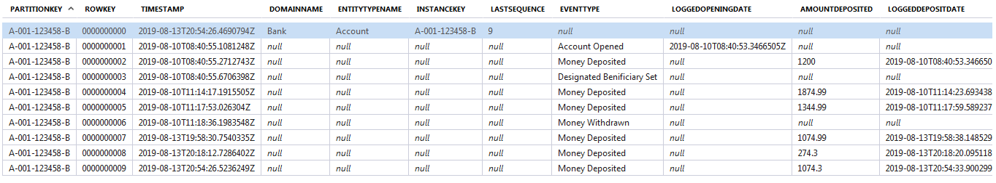
Open a new account
INSTANCE
SEQUENCE
EVENT TYPE
Notes:
The event stream created is stored in the Azure table storage under a table name made of Domain name and Entity Type

Slide 15
Make a deposit
Target account for the deposit must exist
Deposit amount
Source of the deposit (optional)
Notes:
Next we need to make a deposit.
Depositing money is the simplest of all operations - we simply need to be sure that the account exists.

Slide 16
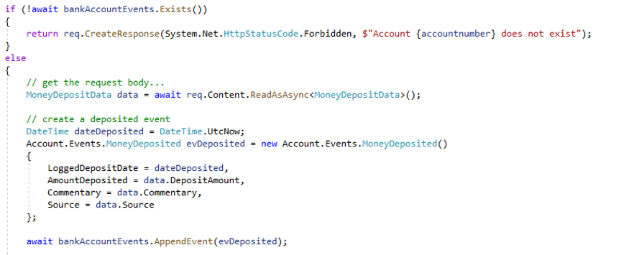
Make a deposit
Notes:
Making a deposit is the simplest function – we simply populate a money deposited event and append it to the event stream for the given bank account.
We check the bank account exists first in case the user has incorrectly entered their account number

Slide 17
Get the balance
The account number to get the balance from must exist
As of date (optional)
Notes:
Getting the balance our of the event stream
To get the balance of the account we need to run a projection over the bank account event stream which handles the money deposited event and the money withdrawn event to give the balance as at a given point.

Slide 18
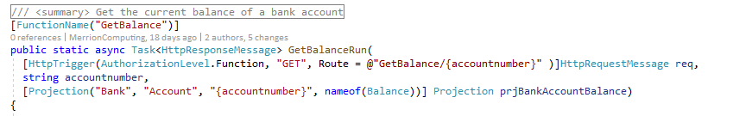
Get the balance
TYPE OF PROJECTION TO RUN
Notes:
To run a projection we need to specify the domain, entity type and instance identity of the event stream we are going to run the projection over, and also we need to specify the class of the projection to run.

Slide 19
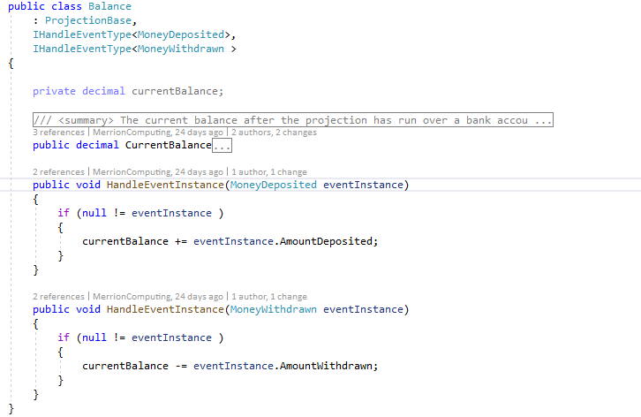
Balance projection
Notes:
The projection is a very simple piece of code that says what events it will handle (by implementing the IHandleEventType interface) and then has a method to be called each time an instance of that event type is encountered in the event stream.
In this case a money deposited event increases the account balance and a money withdrawn event decreases it.

Slide 20
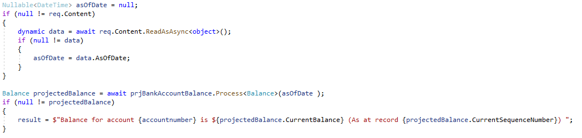
Get the balance
SEQUENCE NUMBER OF LAST EVENT PROCESSED
Notes:
The projection is run and when it has processed all the events in the event stream the value is returned.
1) Every projection also has a Current Sequence Number property that tells you the number of the last event in the stream that it read

Slide 21
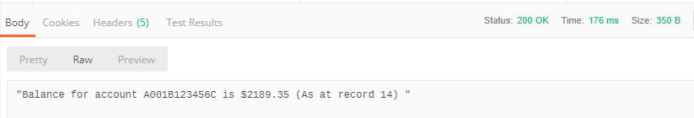
Get the balance
Notes:
Resulting event stream

Slide 22
Make a withdrawal
Target account number for the withdrawal must exist
Balance must be greater than or equal to the withdrawal amount
Concurrency crocodile!
Withdrawal amount
Notes:
Next making a withdrawal
Withdrawing money requires running the balance projection to make sure that the account has the funds available to withdraw and only if it does, post the withdrawal event.
We need to make sure no events have happened between us getting the balance and applying the withdrawal even as if they have we could have a concurrency error.
When posting the withdrawal event we pass in the sequence number returned by the projection and if any other events have been written to the event stream since then an error is thrown and our withdrawal event is not appended.

Slide 23
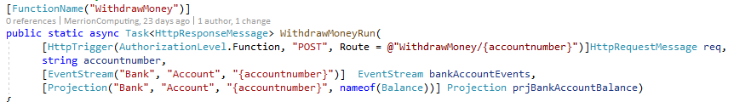
Make a withdrawal
Notes:
The withdrawal function has both an event stream parameter and a projection parameter, both pointing at the same event stream.

Slide 24
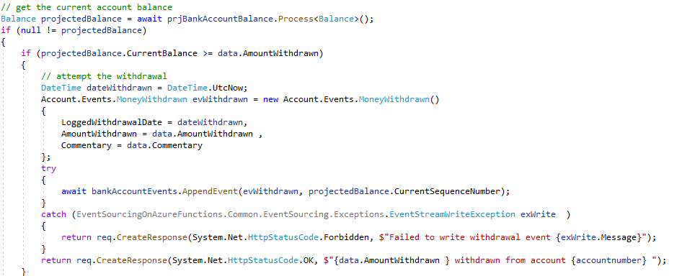
Make a withdrawal
Notes:
By passing in the sequence number we got from the projection we can tell the AppendEvent method to throw an exception if the actual top sequence of the event stream is higher than that when it comes to write the event – this prevents a concurrency error if another thread appends a withdrawal while you are so doing.

Slide 25
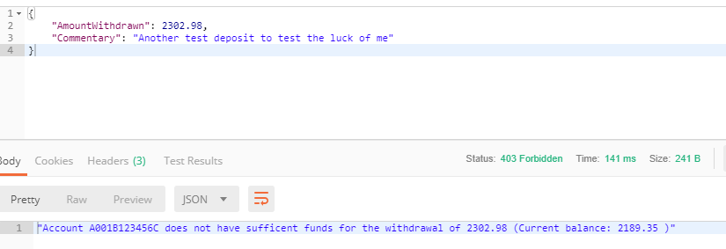
Make a withdrawal
Notes:
The result of this is that we are prevented from withdrawing more money than we have in the account.
So at this stage we have a relatively cheap way of storing state and some logic so we are part of the way to building a system.
Next we need to route instructions to and from our application components – for which I use Event Grid

Slide 26
Q & A

Slide 27
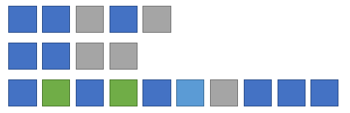
Notifications
“domain.entity type.NewEntity"
DOMAIN
ENTITY TYPE
INSTANCE
New entity
“domain.entity type.event type"
DOMAIN
New event
ENTITY TYPE
INSTANCE
Event streams
EVENT TYPE
SEQUENCE
(EVENT DETAILS PAYLOAD)
Notes:
When a change occurs the system raises notifications that others can listen out for and optionally act upon

Slide 28
Notifications
“domain.entity type.projection type"
DOMAIN
ENTITY TYPE
Projection run
INSTANCE
PROJECTION TYPE
SEQUENCE
(PROJECTION RESULT PAYLOAD)
Event streams
“domain.entity type.classification type"
Classification run
DOMAIN
ENTITY TYPE
INSTANCE
PROJECTION TYPE
SEQUENCE
CLASSIFICATION RESULT
Notes:
Also – when a projection is run we broadcast the result of that projection as a notification so that any interested parties can, for example, update their reference data and likewise when a classification is run.

Slide 29
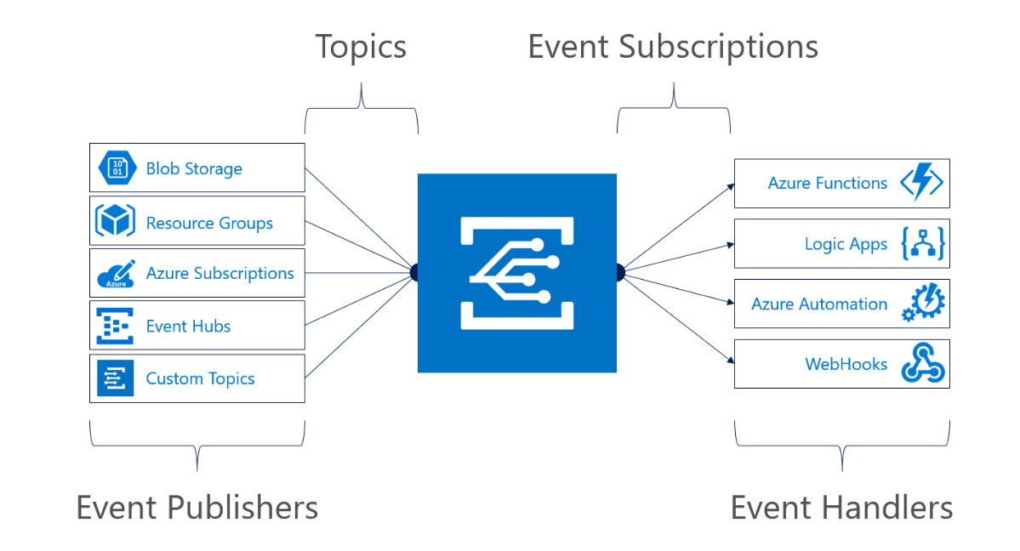
Introduction to Event Grid
At-least once delivery
Always on
Notes:
Event grid is how notifications, commands and queries are passed around my system.
Event grid is “always listening” – if it receives a notification it can trigger an invocation (“wake up”) of the azure function(s) subscribing to it.
Event grid will retry sending to a subscription if the send does not succeed – if they fail for 24 hours then the message will be put in a “deal letter” location.
Events will be delivered at least once – but possibly more than once, so you should code defensively for that possibility

Slide 30
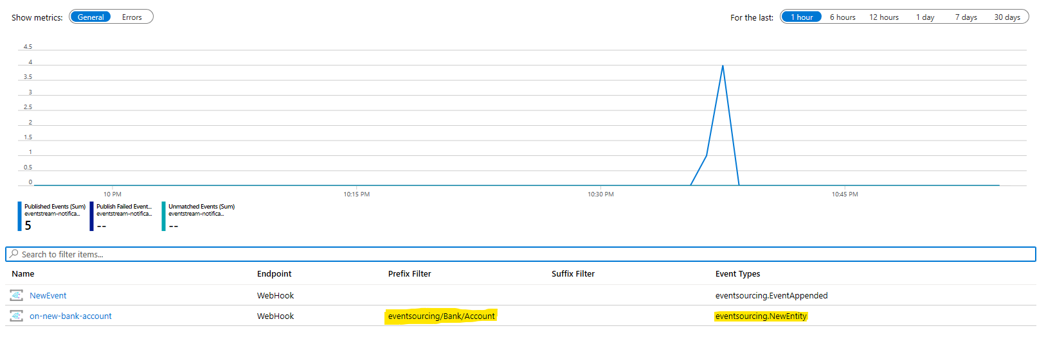
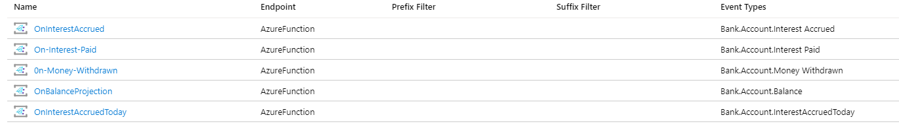
Event Grid filtering

Slide 31
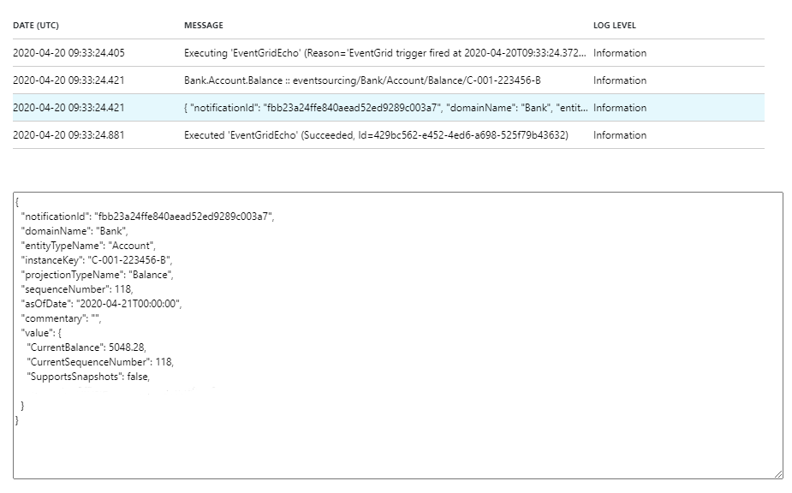
Event grid message content
Notes:
This is what the message looks like when it comes off Event Grid

Slide 32
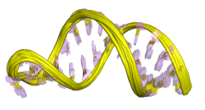
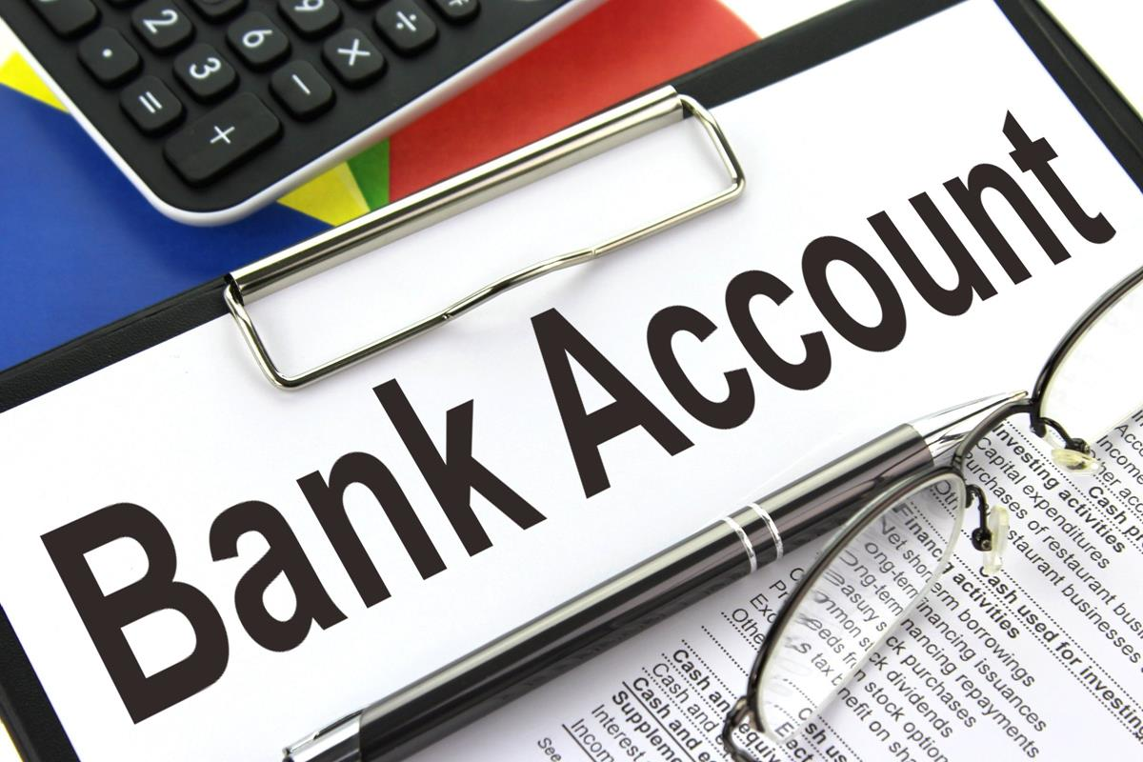


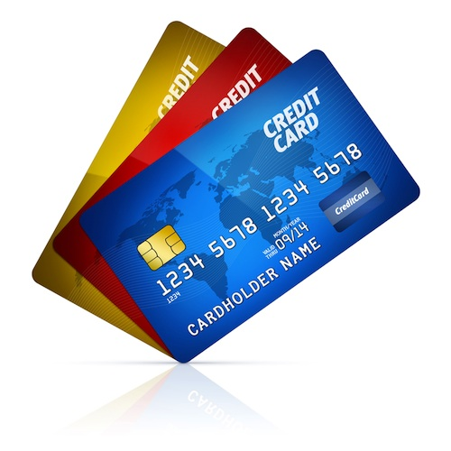
Overview of an example system architecture
Accounts
Branches
Query
Query
Command
Notifications
Command
Products
Command
Query
Notes:
The demonstration system is for organising a retail bank.
It is split into three domains – the accounts domain being anything to do with the overall organisation of customer accounts,
The branches domain being to do with physical bank locations,
The products domain being the different offerings that the retail bank markets.
The domains have very different scaling profiles so they are each implemented in their own Azure Functions “app”.
Importantly there is no privileged communication between the domains – the interface available to each other is the same interface publicly available outside.

Slide 33


Handling a command
Durable Function Orchestration
Append
Event(s)
Command name
Parameters
Context
Command
Validations
Notes:
A command is issued to the system through an event grid topic.
The parameters required to perform the command as well as any authorisation tokens and externally supplied unique identifier are supplied in the payload to this event grid topic.
When a message is received by the topic it triggers a serverless function to handle the command.
This uses the durable function framework to call activities that perform each step in turn and, if all is OK, appends 1 or more events to the event streams of the entities updated by the command.
As well as the built in durable function orchestration which is backed by a table the command has its own event stream in which the progress is logged.

Slide 34
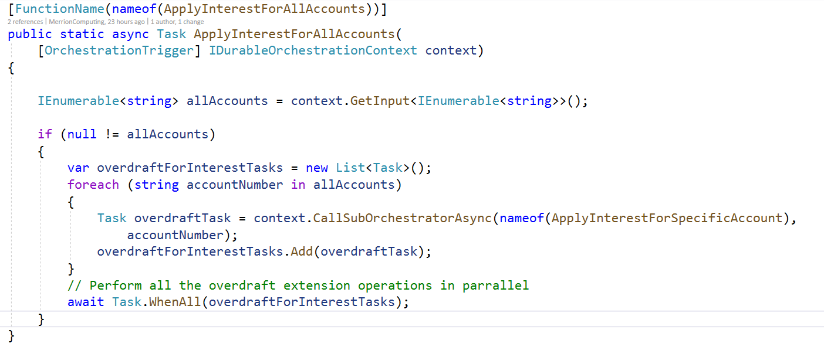
Command – apply interest to all accounts
Trigger Orchestration
Fan-out sub orchestration
Step 1
Step 2
Notes:
The orchestration function has an [OrchestrationTrigger] attribute and durable orchestration through which the details of what kicked off the orchestration can be found

Slide 35
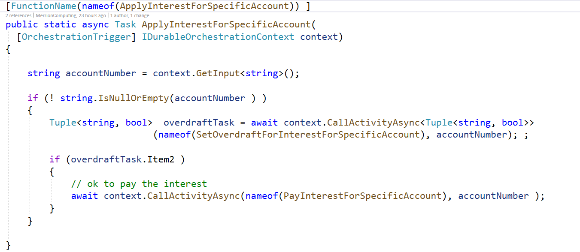
Sub-orchestration
Trigger Orchestration
Fan-out sub orchestration
Step 1
Step 2
Notes:
The orchestration calls out to Activity methods which do the actual work of each step

Slide 36
Handling a query
Durable Function Orchestration
Query name
Parameters
Context
Return addresses
Query
Validations
Run
Projection(s)
Return
Results
Notes:
A query is handled in a similar manner but in addition to the parameters you also pass in a return address to which the results of the query should be returned.
This could be, for instance, a webhook or an azure storage location to drop a file into.
This allows the query to be executed asynchronously.
The query runs projections over the event streams of the entities it is getting data for and then performs any aggregation needed over these before returning the results.

Slide 37
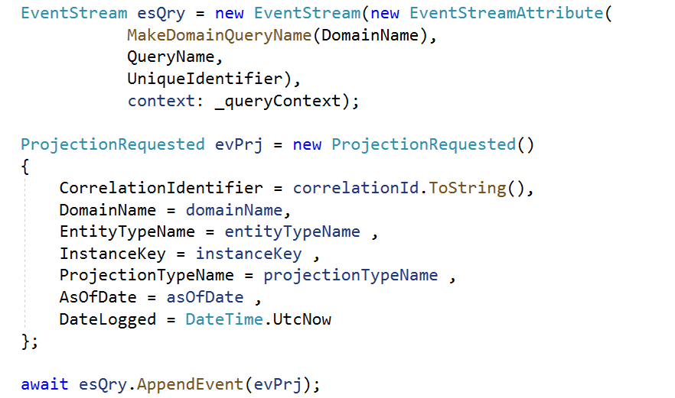
Query orchestrator
Trigger Orchestration
Validate Parameters
Run Projections
Send Results
Request Projections
Notes:
Projection requests are written to the query event stream so we can see what work has been done and what is outstanding in running the query
Projections themselves can then be run in parallel by using durable functions “fan-out” mechanism.
Once all the projections are complete any totting up steps could run.

Slide 38
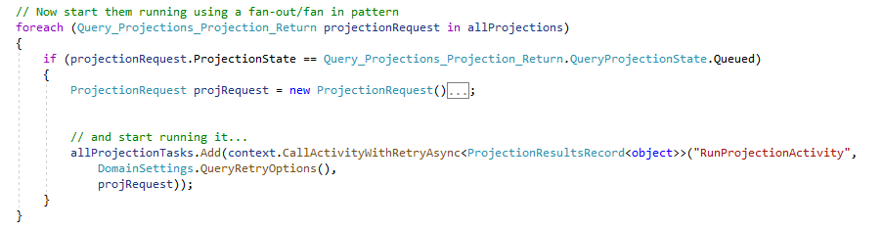
Query orchestrator
Trigger Orchestration
Validate Parameters
Run Projections
Send Results
Request Projections
Notes:
Projection requests are written to the query event stream so we can see what work has been done and what is outstanding in running the query
Projections themselves can then be run in parallel by using durable functions “fan-out” mechanism.
Once all the projections are complete any totting up steps could run.

Slide 39
Code and architecture recap
Event Grid function triggers
Event sourcing with Azure functions
Query orchestration
Command orchestration
Fan-out
Event streams and projections
https://github.com/MerrionComputing/EventsSourcing-on-Azure-Functions
Notes:
Event Grid for the reliable messaging between domains (and with the outside world) – this allows us to stitch together domains with publish-subscribe, which means we can easily extend the system.
Serverless function hosting for dynamic scaling.
Durable Function Orchestration for the long running processes that handle the commands and queries.
Durable functions fan out/fan in for processes that can run in parallel.
Event sourcing to save on the overhead required by using a database.

Slide 40
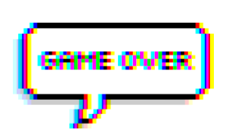
Q & A

Slide 41
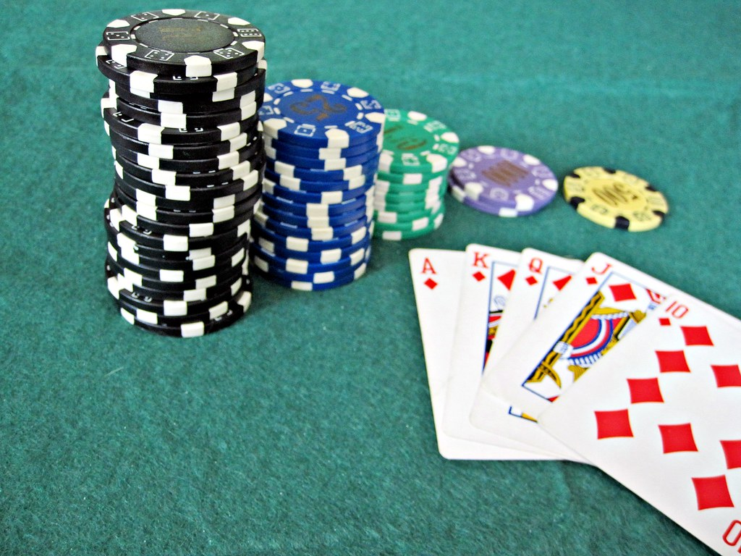


Serverless – time to go all in?
COMPUTE
COMMUNICATE
STORE

